Slide 1

Sales Performance Analysis Q1 2024 (Jan 2024)
Prepared by Omkar Abhyankar
Date : 20 Sept 2024

Slide 2

Agenda
Introduction
Key Metrics Overview
Sales Growth Analysis
Regional & Product Performance
5 .Recommendations
6. Conclusion

Slide 3

Introduction
Data used for this analysis was sourced from the company's sales database covering the period of January 1st to January 31st, 2024. Key metrics included Total Sales revenue, Top-selling Products, Sales by Region, and Customer Segmentation

Slide 4

Key Metrics Overview
Total Sales: $460,000M
Best Region: East (Average Order value 42)
Best Product: P004 (Total Sales $140M)

Slide 5


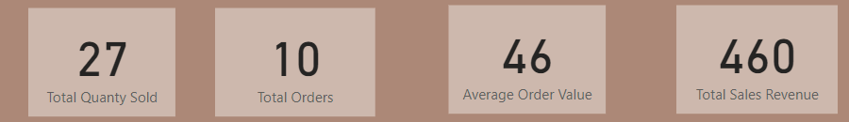
Sales Growth Analysis
As per the region West side region is doing good as compare to South

Slide 6
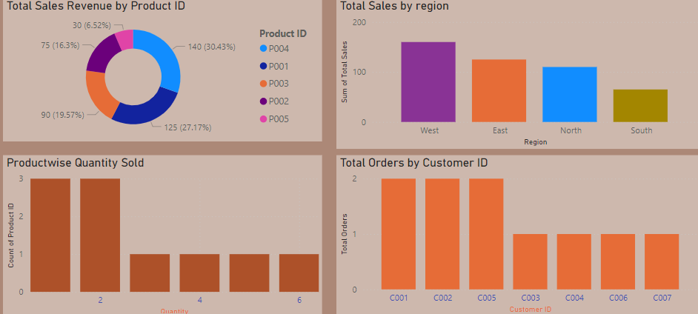

Regional & Product Performance
With this chart we can see the West side region is doing good and South region is doing not so well.

Slide 7

Recommendations
Increase inventory and marketing efforts in Product P005.
Investigate sales decline in South Region and consider targeted promotions.

Slide 8

6. Conclusion
Overall, January performance was strong, with significant growth in Product P005 and South Region .
Areas for improvement include South Region B and Product P004
Recommended actions have been outlined to sustain growth and improve underperforming areas."

